Slide 1
May Already Know More Than You Think: Leverage User Data You Already Have To Get Started
Kathryn Downey Piscopo, Ph.D. – Center for Behavioral Health Statistics and Quality, SAMHSA
Dara Pressley – Director of User Experience, SAMHSA contractor
2022 Government UX Summit
June 7, 2022 (1:10-1:30 pm)
Disclaimer: The view, opinions, and content of the authors do not necessarily represent the view, opinions, and policies of CBHSQ, SAMHSA, or HHS.

Slide 2
2
The beginning of every effort, is a good time to figure out what you already know. Information previously gathered, previously created work, request for site users, and wishes of the organization.
Then gathering this information together, form a story of the opportunities, the gaps, and what is still left to learn.

Slide 3
This is the story of how we did this on
The Substance Abuse and Mental Health Data Archive (SAMHDA)

Slide 4
Best Practice is To Triangulate Data (Meaning, Use Multiple Streams).
Discovery
Industry Best Practices and Principles (USWDS)
Listening Sessions (Stakeholders)
Usability Testing
Coding Help Desk Tickets
A/B Testing
UX Expert Review
Audience Analysis
Comparative Analysis
Web Analytics Tool
Qualitative
Quantitative

Slide 5
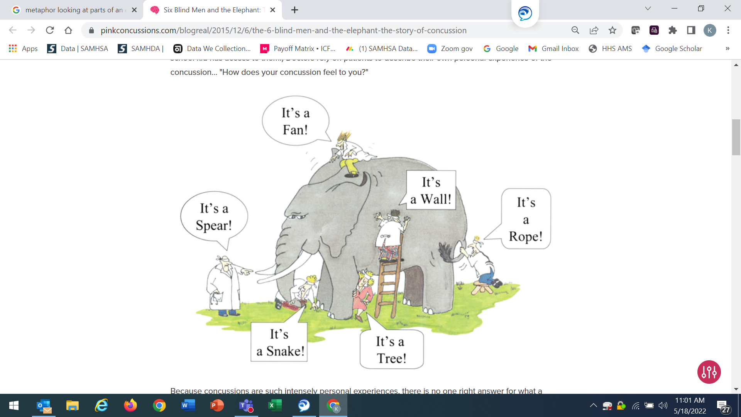
You Should Use All the Data You Can.
“Blind Men and the Elephant” by Climate Interactive is licensed under C BY-NC-SA 2.0

Slide 6
We Used These Streams Before Redesigning.
Discovery
Industry Best Practices and Principles (USWDS)
Listening Sessions (Stakeholders)
Usability Testing
Coding Help Desk Tickets
A/B Testing
UX Expert Review
Audience Analysis
Comparative Analysis
Web Analytics Tool
Qualitative
Quantitative

Slide 7
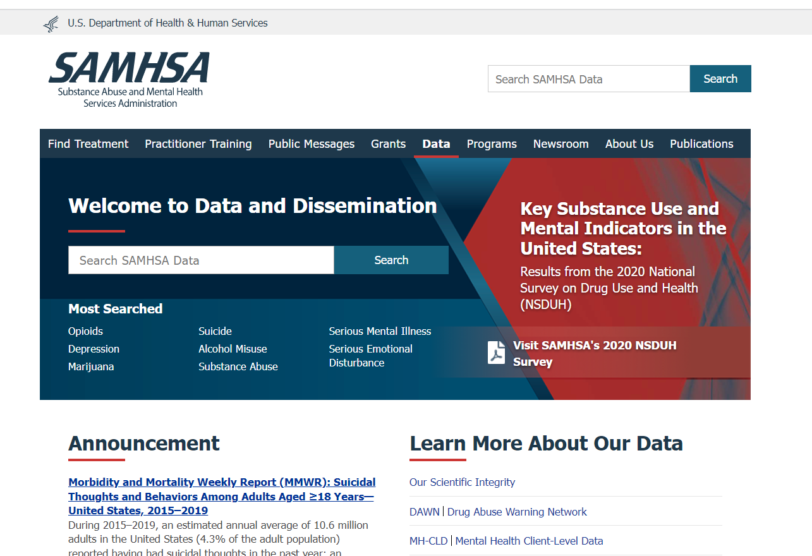
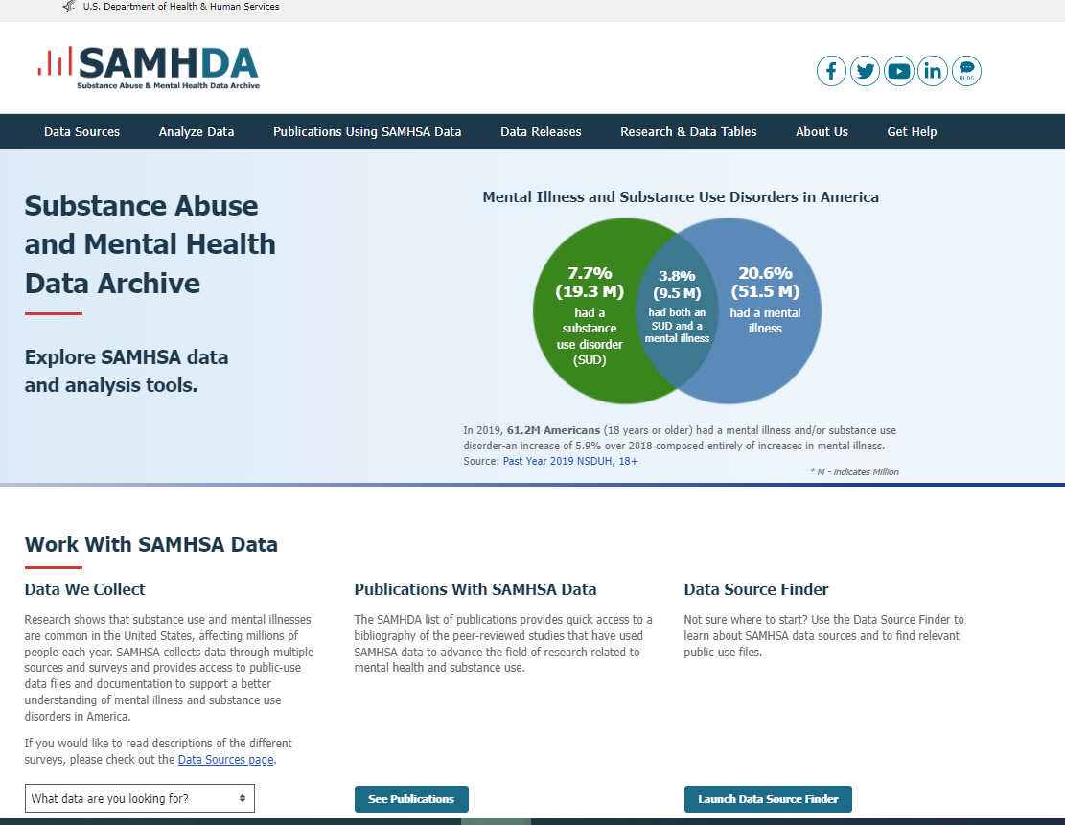
We Had Completed Some Previous Work.
We had completed a redesign of the "data" page (left)
This gave us a head start on the SAMHDA, or data analysis, page (right)

Slide 8




You Should Know Your Audience. (Audience Analysis)
Vinaya | Journalist
Michael | Public Health Analyst
Ianne | Researcher / Statistician
Eric | Government Relations Director
Images purchased from iStockPhoto

Slide 9
What are Some Websites with Great User Experience? (Comparative Analysis)
People coming to your site have experience throughout the web and have come to develop expectations.
Reviewing other websites helps to give inspiration as well as finding best practices.
We want to look at sites that have similar purposes... but also sites that have features that inspire to elevate and innovate.
We were able to build on our learnings by reviewing past comparatives while adding to the collection
Data.gov
CMS.data.gov
American Fact Finder
JAMA
Science Magazine
NIH
USDA
Census.gov
Many commercial sites

Slide 10
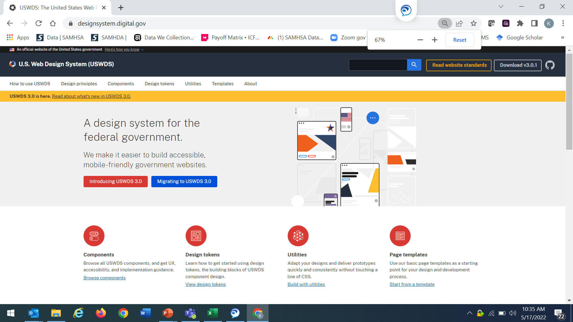
You Should Use Industry Best Practices.
Probably also have “style guide” at agency
US Web Design System (USDWS): https://designsystem.digital.gov/
Wireframe of best practices, but allows for customization and branding

